Slide 1
Moodle Training — Advanced Topics —
Office of Information Technology

Slide 2
Overview of Topics to be Covered
Gradebook Aggregation
Course Beautification
Lessons

Slide 3
– Topic 1 – Grade Aggregation Topics
Weighted Mean, Simple Weighted Mean, and Natural

Slide 4
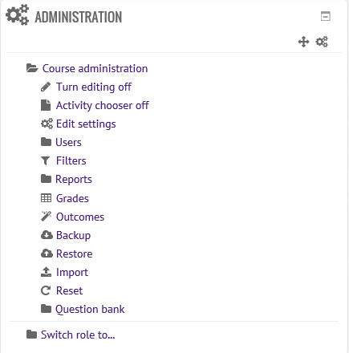
Gradebook Setup
Gradebook can be edited to suit your specific needs.
Grades can be grouped into categories for ease of use.
Grades can also be weighted.
All grade settings are changed in Gradebook.

Slide 5
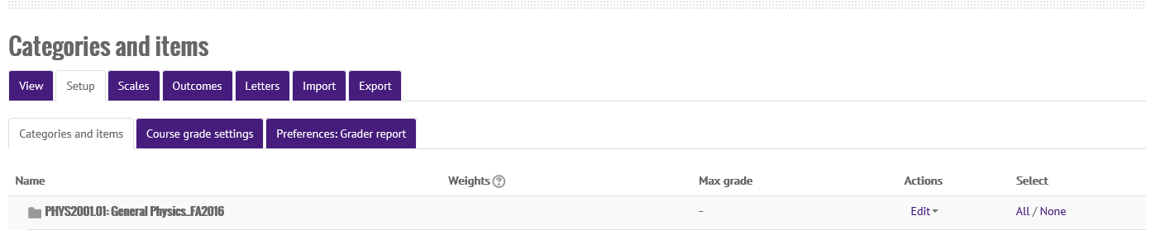
Gradebook Setup
Once Gradebook is opened, selecting the “Setup” tab will allow instructors to manually add grade items, create and manage grade categories, manage category/item weights, and much more.

Slide 6
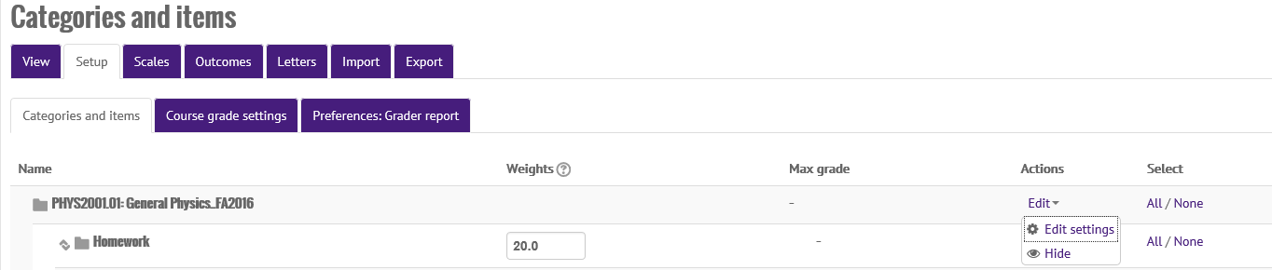
Changing the Gradebook Aggregation Method
For grade calculations, myCourses uses one of three aggregation methods.
To change the aggregation method for your course’s gradebook, select the “Edit” drop-down shown on the same line as your course’s name.
Then click “Edit settings.”

Slide 7
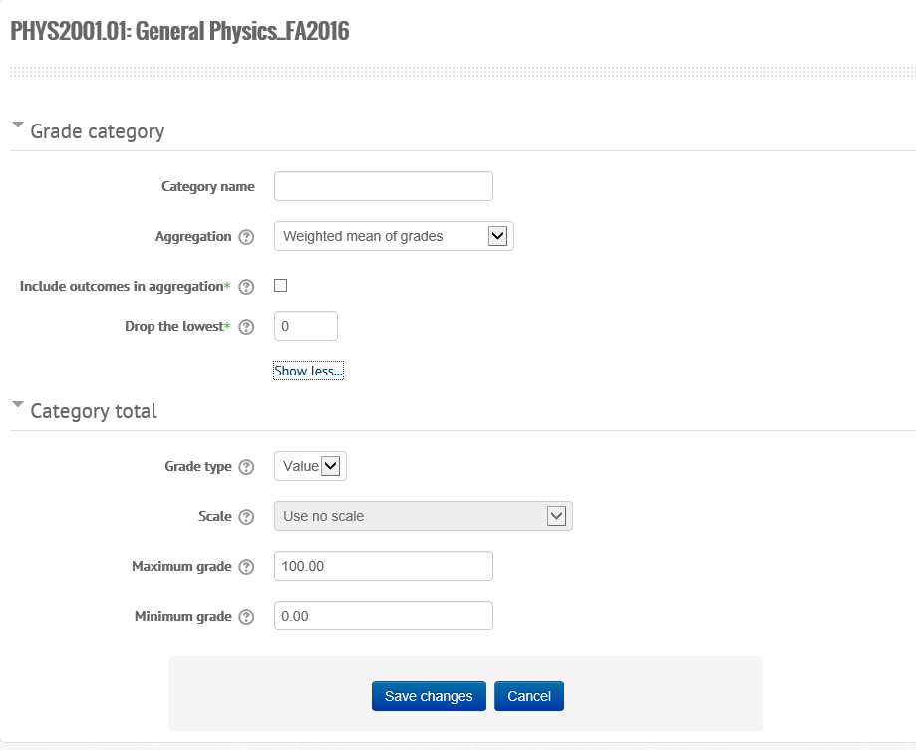
Changing the Gradebook Aggregation Method
Now you’re able to manage how the grades are calculated for the entire course.
The “Aggregation” option allows you to select which grading method you would like to use.
Also note that there is an option to drop the lowest grade(s).

Slide 8
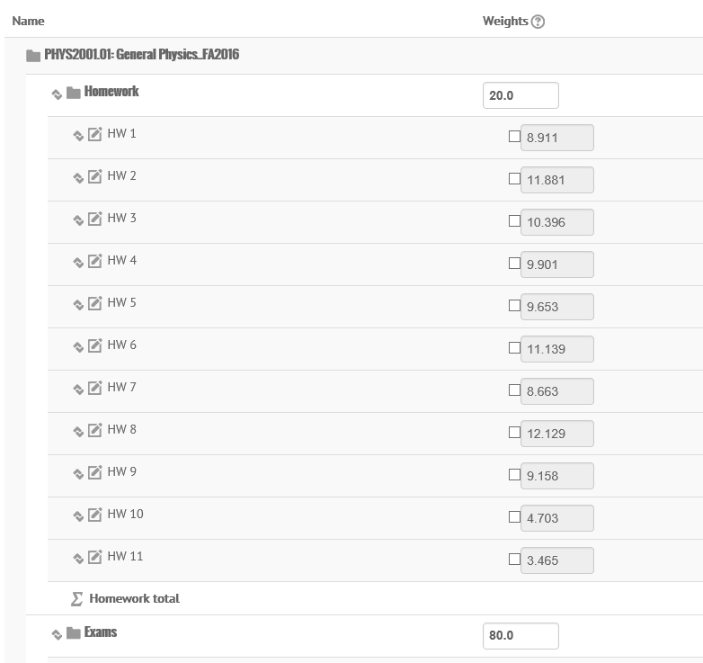
Weighted Mean of Grades
This method of aggregation is best used with grade categories.
With it, you can assign each category to be worth a certain percentage of the overall course’s grade.
For example:
In my PHYS 2001 course, the homework that students do is worth 20% of their grade.
Exams make up the remaining 80%.

Slide 9
Weighted Mean of Grades
As an example, let’s consider the following grade set:
For this example, we will allow the homework to be weighted at 30% and the exams at 70%.
Homework Assignments (30%) |  |  |  | Exams (70%)
 | Student Score | Total Possible |  |  | Student Score | Total Possible
HW 1 | 18 | 20 |  | E 1 | 88 | 100
HW 2 | 31 | 35 |  | E 2 | 55 | 100
HW 3 | 10 | 15 |  | E 3 | 76 | 100
HW 4 | 5 | 25 |  | TOTAL | 219 | 300
TOTAL | 64 | 95

Slide 10
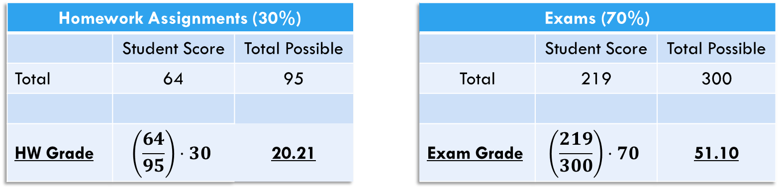
Weighted Mean of Grades
Moodle multiplies the category total by the weight.
If there are no categories, Moodle will multiply the weight by the individual grade total.
So, for our example…
Homework Assignments (30%) |  |  |  | Exams (70%)
 | Student Score | Total Possible |  |  | Student Score | Total Possible
Total | 64 | 95 |  | Total | 219 | 300
HW Grade | $$\left(\frac{64}{95}\right)⋅30$$ | 20.21 |  | Exam Grade | $$\left(\frac{219}{300}\right)⋅70$$ | 51.10

Slide 11
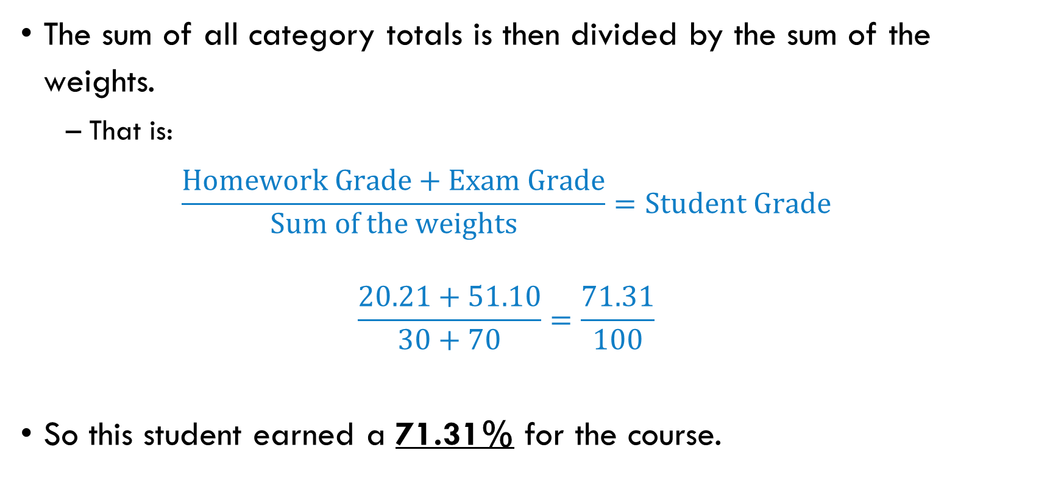
Weighted Mean of Grades
The sum of all category totals is then divided by the sum of the weights.
That is:
$$\frac{\text{Homework} \text{Grade}+\text{Exam} \text{Grade}}{\text{Sum} \text{of} \text{the} \text{weights}}=\text{Student} \text{Grade}$$
$$\frac{20.21+51.10}{30+70}=\frac{71.31}{100}$$
So this student earned a 71.31% for the course.

Slide 12
Simple Weighted Mean of Grades
For the Simple Weighted Mean of Grades, Moodle uses the total possible points as the weight of an assignment (or category).
So, let’s consider the same set of grades.
Student Grades
 | Student Score | Total Possible
HW 1 | 18 | 20
HW 2 | 31 | 35
HW 3 | 10 | 15
HW 4 | 5 | 25
E 1 | 88 | 100
E 2 | 55 | 100
E 3 | 76 | 100

Slide 13
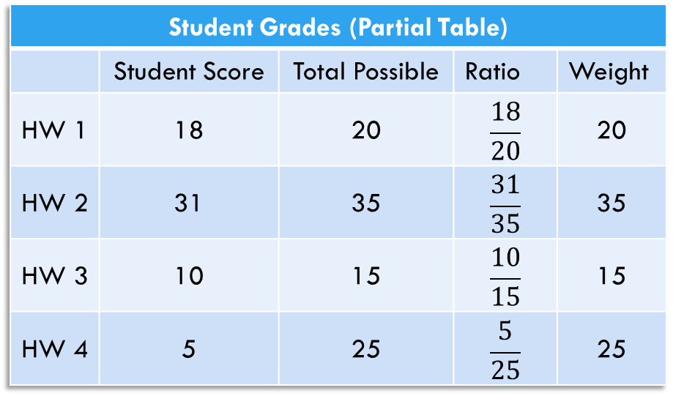
Simple weighted Mean of Grades
Each grade is calculated individually (if no categories are employed).
That ratio (score/total) is then multiplied by the total possible points.
Student Grades (Partial Table)
 | Student Score | Total Possible | Ratio | Weight
HW 1 | 18 | 20 | $$\frac{18}{20}$$ | 20
HW 2 | 31 | 35 | $$\frac{31}{35}$$ | 35
HW 3 | 10 | 15 | $$\frac{10}{15}$$ | 15
HW 4 | 5 | 25 | $$\frac{5}{25}$$ | 25

Slide 14
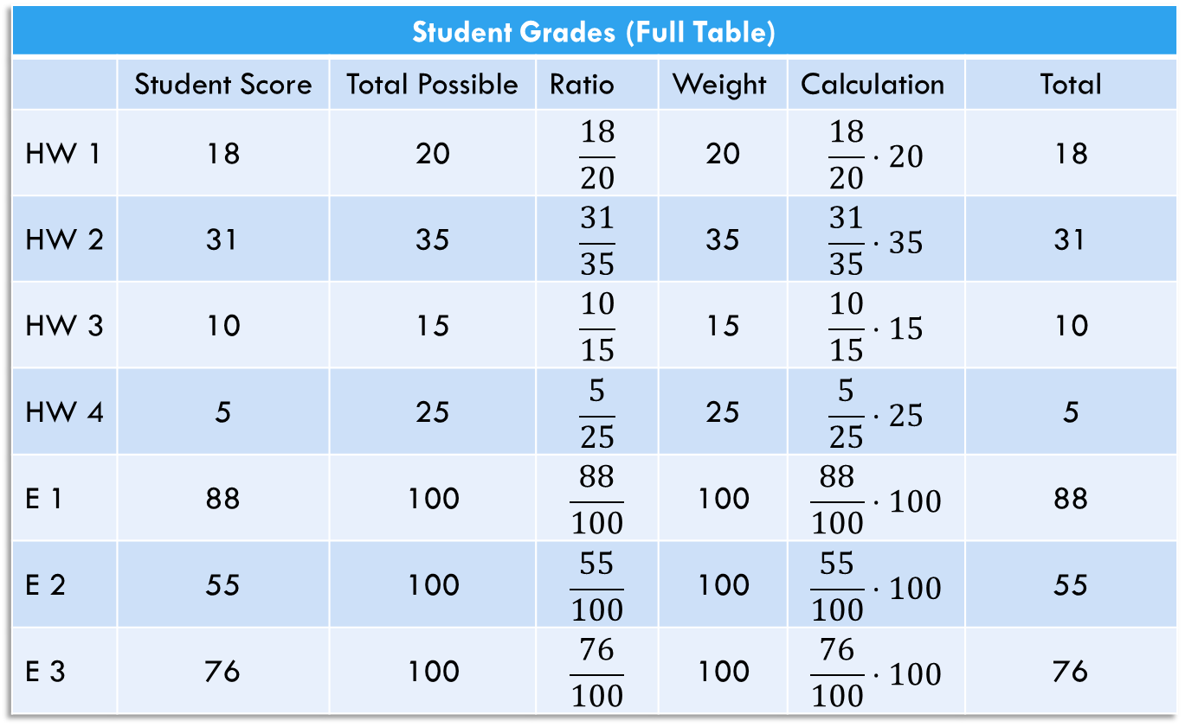
Simple Weighted Mean of Grades
Student Grades (Full Table)
 | Student Score | Total Possible | Ratio | Weight | Calculation | Total
HW 1 | 18 | 20 | $$\frac{18}{20}$$ | 20 | $$\frac{18}{20}⋅20$$ | 18
HW 2 | 31 | 35 | $$\frac{31}{35}$$ | 35 | $$\frac{31}{35}⋅35$$ | 31
HW 3 | 10 | 15 | $$\frac{10}{15}$$ | 15 | $$\frac{10}{15}⋅15$$ | 10
HW 4 | 5 | 25 | $$\frac{5}{25}$$ | 25 | $$\frac{5}{25}⋅25$$ | 5
E 1 | 88 | 100 | $$\frac{88}{100}$$ | 100 | $$\frac{88}{100}⋅100$$ | 88
E 2 | 55 | 100 | $$\frac{55}{100}$$ | 100 | $$\frac{55}{100}⋅100$$ | 55
E 3 | 76 | 100 | $$\frac{76}{100}$$ | 100 | $$\frac{76}{100}⋅100$$ | 76

Slide 15

Simple Weighted Mean of Grades
Once the weights are applied to each grade, they are summed.
That sum is divided by the sum of the weights.
Student Grades
 | Total | Weight
HW 1 | 18 | 20
HW 2 | 31 | 35
HW 3 | 10 | 15
HW 4 | 5 | 25
E 1 | 88 | 100
E 2 | 55 | 100
E 3 | 76 | 100
TOTAL | 283 | 395
So, for our example, the student’s score is: $\frac{283}{395}=0.7165$
That is, 71.56%.

Slide 16
Natural
If you didn’t catch it in the previous slides, the simple weighted mean of grades will return the exact same grade as the natural aggregation.
The student scores are added to a single total.
The total possible points are added to a single total.
To get the grade, simply divide the student score total by the sum of the total possible points.

Slide 17
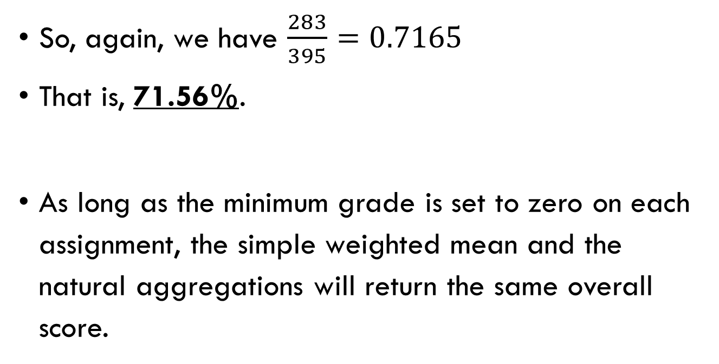
Natural
Student Grades
 | Student Score | Total Possible
HW 1 | 18 | 20
HW 2 | 31 | 35
HW 3 | 10 | 15
HW 4 | 5 | 25
E 1 | 88 | 100
E 2 | 55 | 100
E 3 | 76 | 100
TOTAL | 283 | 395
So, again, we have $\frac{283}{395}=0.7165$
That is, 71.56%.
As long as the minimum grade is set to zero on each assignment, the simple weighted mean and the natural aggregations will return the same overall score.

Slide 18
– Topic 2 – Course Beautification Topics
Adding media to the course page.

Slide 19
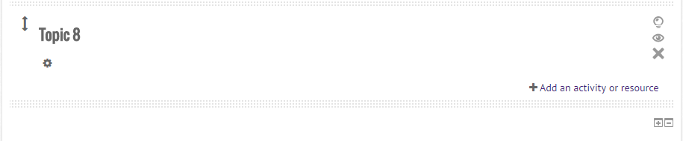
Embedding Items
As with any change on the main course page, improving the look of your course begins with the “Turn Editing On” button.
Once the editing is enabled, you can add images, video, or other media to a topic by editing the settings of the topic.

Slide 20
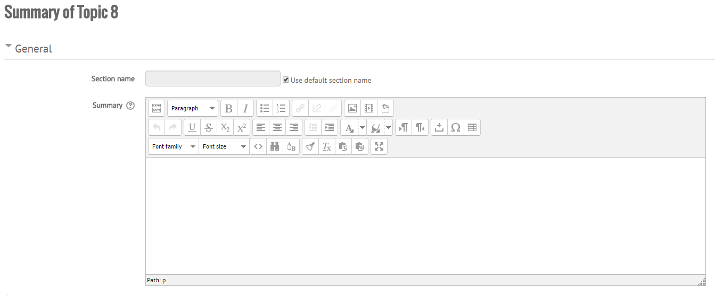
The Topic Summary
The default name is Topic (#).
Removing the check allows you to name the topic whatever you want.
Add media (pictures, videos, sound, etc.) here.
Add descriptive material and media about the topic.

Slide 21
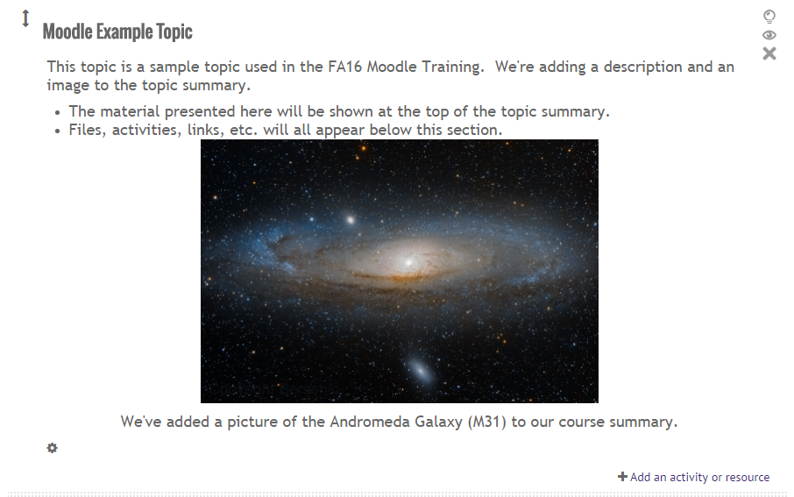
The Topic Summary
Any descriptions, directions, media, or anything else that is added to the topic summary will be displayed at the top of the topic section.
Next, we will see how to add media within the topic materials.

Slide 22
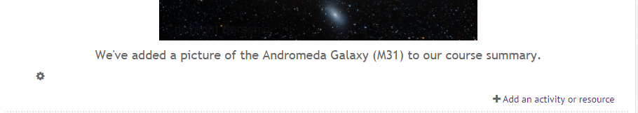
Adding Media In Other Places
The Topic Summary is not the only place where media can be added.
Labels can also be used to spruce up your course page.
Not only do they divide large sets of material, but they may contain media as well.
To add a label into your course, click “Add an activity or resource.”

Slide 23
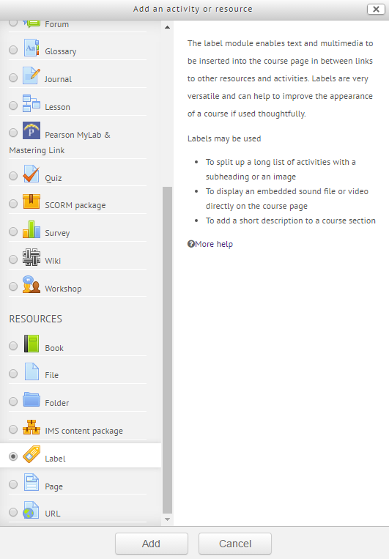
Adding A Label
To quote Moodle:
“Labels may be used
To split up a long list of activities with a subheading or an image
To display an embedded sound file or video directly on the course page
To add a short description to a course section”

Slide 24
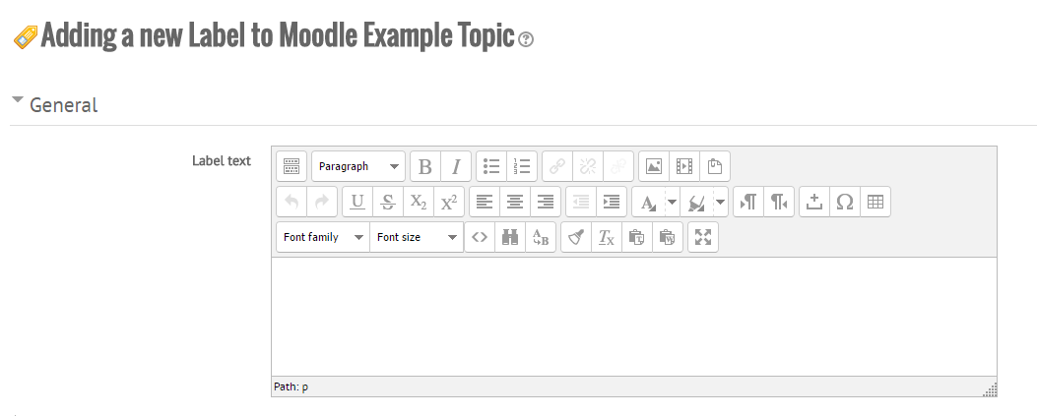
Adding Material to a Label
Notice that the interface for adding text and media to a topic summary is the same interface for adding material to a label.
Add media (pictures, videos, sound, etc.) here.
Add the text and media for the label to display.

Slide 25
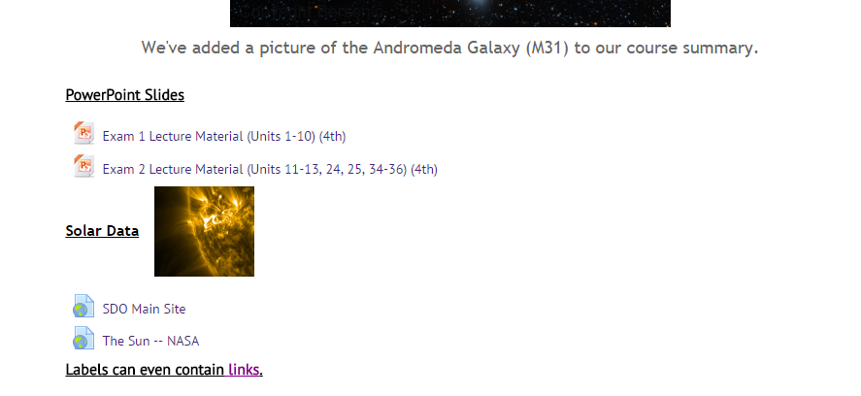
Material Within Labels
A standard label.
A label with an image.
The image may be displayed below the wording of a label.
A label with a link.

Slide 26
– Topic 3 – Lessons
Great ways to guide student learning within myCourses.

Slide 27
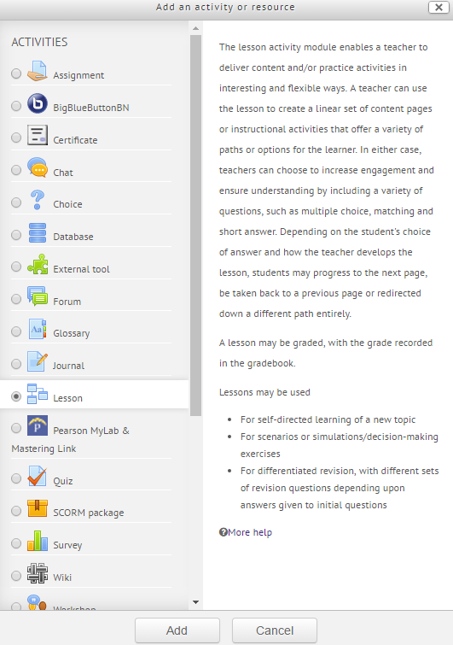
Lessons
Lessons are created by the instructor of the course.
They contain content and question pages.
They may be graded or ungraded.
For assignments or study guides.
The Lesson activity is a fantastic way to guide students toward a concept or specific goal.

Slide 28
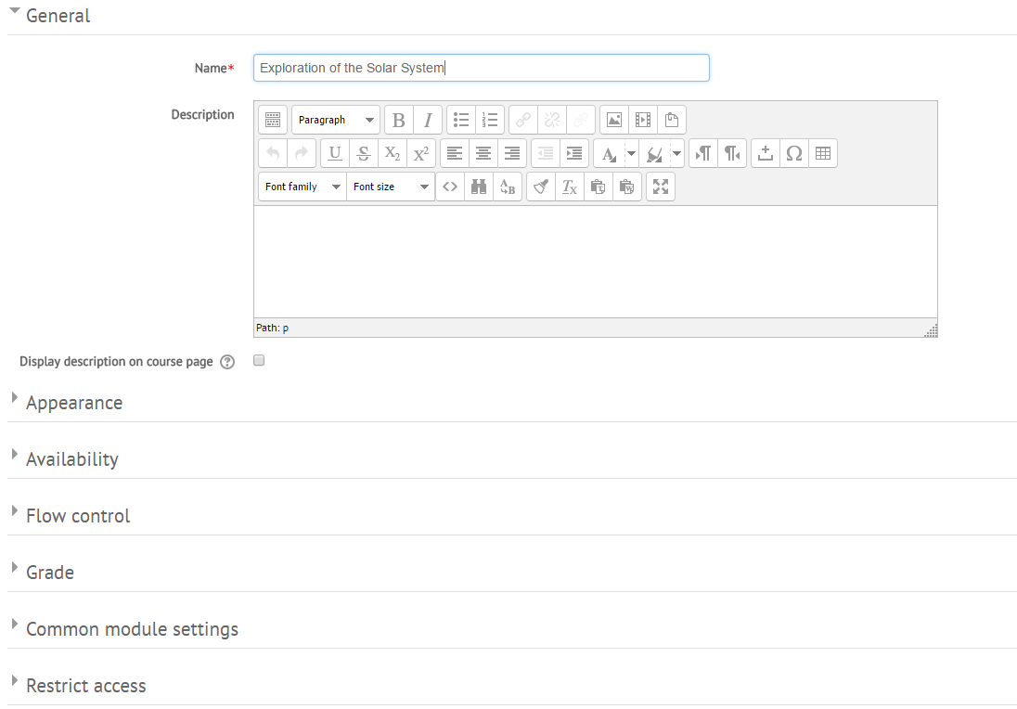
Creating a Lesson
Creating a lesson begins at this page.
Each menu below the Description box manages different aspects of the assignment.
It is on this page that you establish the general settings for the entire assignment.

Slide 29
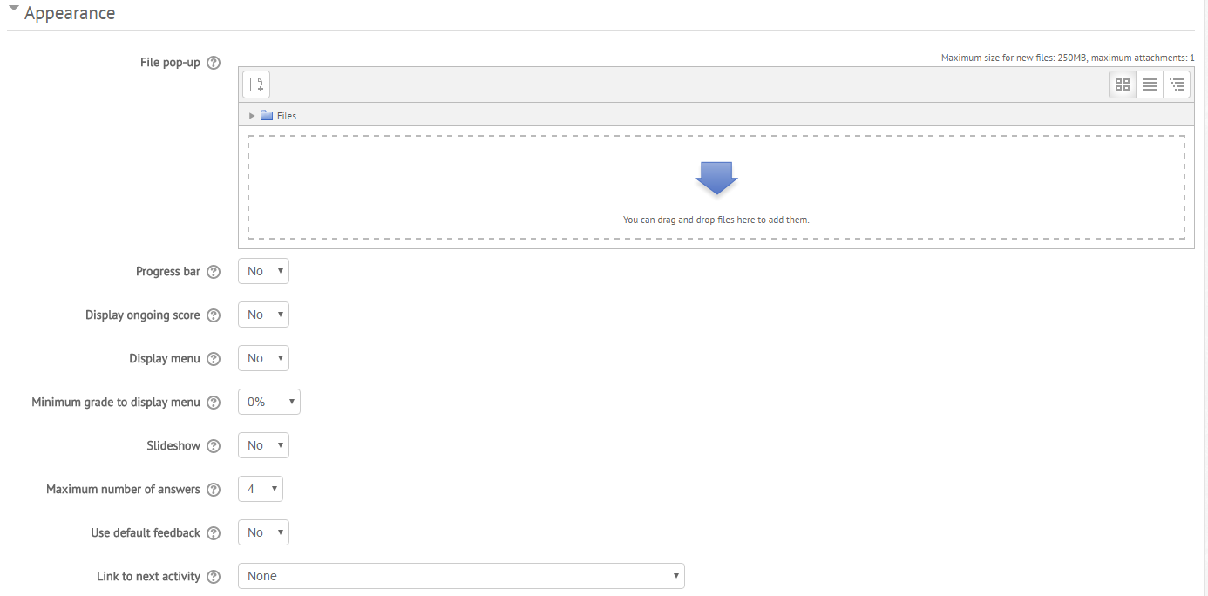
The Appearance Drop-Down
To include a pop-up window at the beginning of a lesson, choose the appropriate file to display. Every lesson page will include a link to re-open the pop-up if necessary.
If enabled, the lesson is displayed as a slideshow, with a fixed width and height.
If enabled, when a response is not found for a particular question, the default response of "That's the correct answer" or "That's the wrong answer" will be shown.

Slide 30
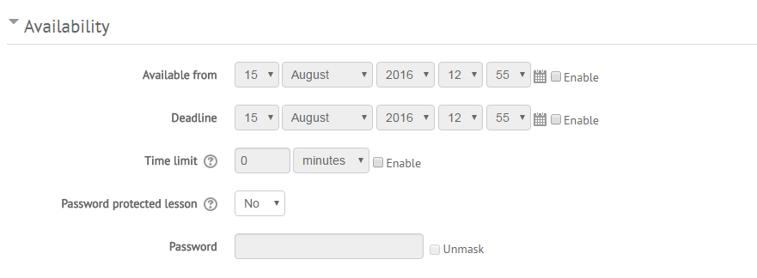
The Availability Drop-Down
The Availability settings allow you to set times for the assignment to open and close, choose a time limit, or password-protect the assignment.

Slide 31
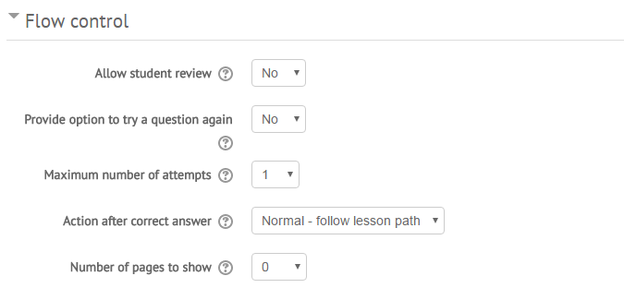
The Flow-Control Drop-Down
The Flow-Control settings allow you to set how the students interact with the assignment.
You may:
Allow students to review the assignment after they have completed it.
Allow the lesson to bring the student to a random, unseen page after they answer a question.
Create a pool of pages from which the lesson may draw (Number of pages to show).

Slide 32
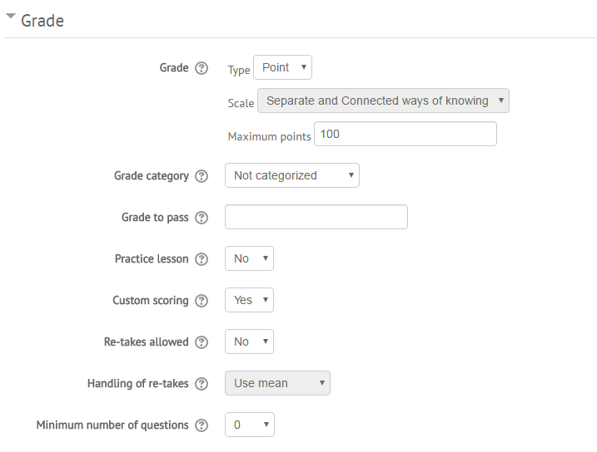
The Grade Drop-Down
Here, you can choose the behavior of the lesson’s grading.
You may:
Set the type of grading system.
Set the maximum points.
Select the grade category.
Allow for a practice lesson (ungraded lesson).
Set point value to custom (you can assign point values in each question).
Set the minimum amount of questions for grading.

Slide 33
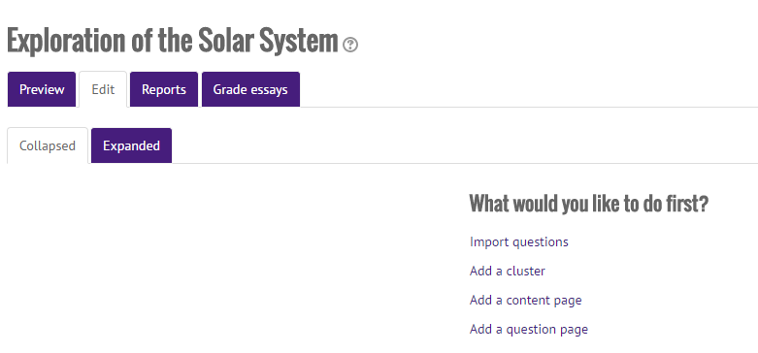
Creating the Lesson Content
Once you have established the lesson settings, myCourses brings you to the editing page.
Here is where you begin to build the lesson pages.
You may preview the lesson as you progress through its creation.
Let’s start off with a content page called “Directions.”

Slide 34
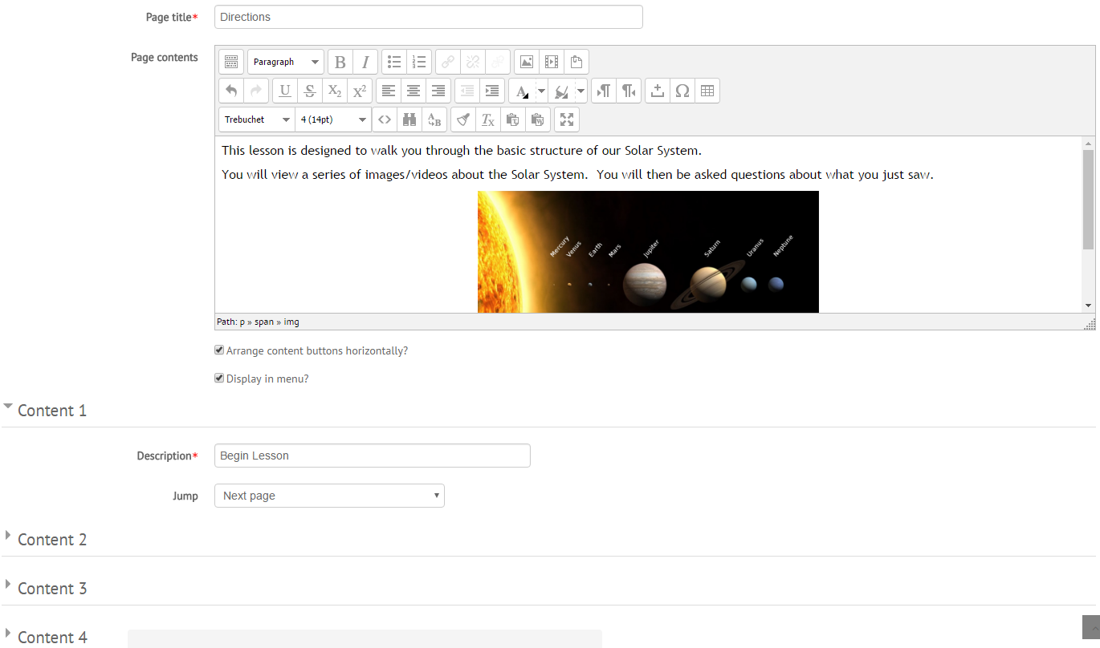
The Content Page
The Content menus create buttons at the bottom of the page for navigation.

Slide 35
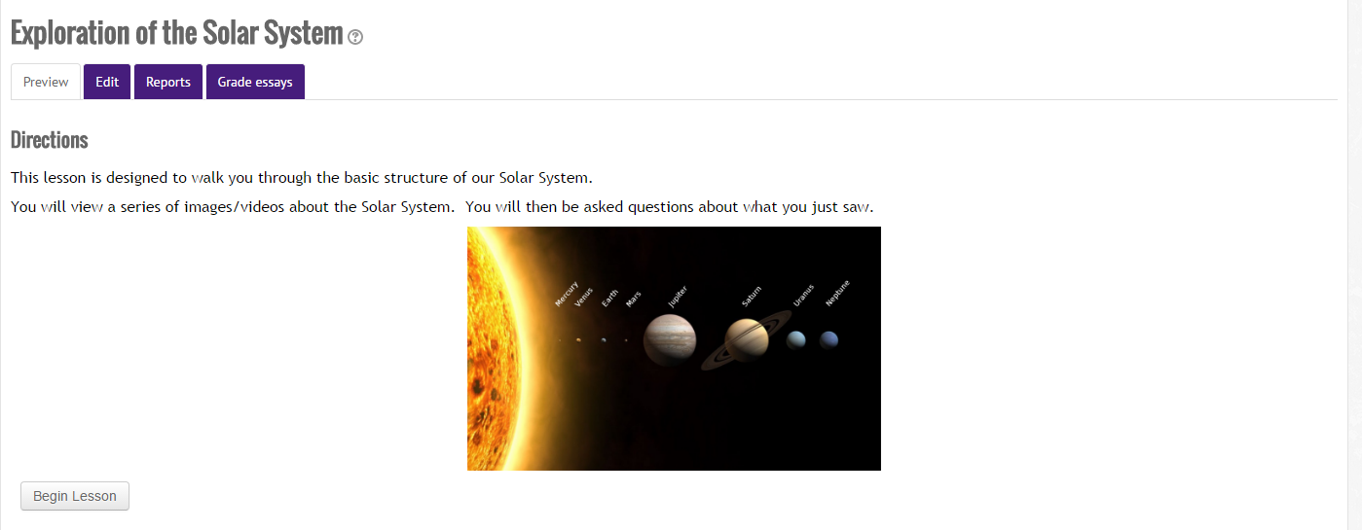
The Content Page
Preview shows us how a student would see the page we just created.

Slide 36
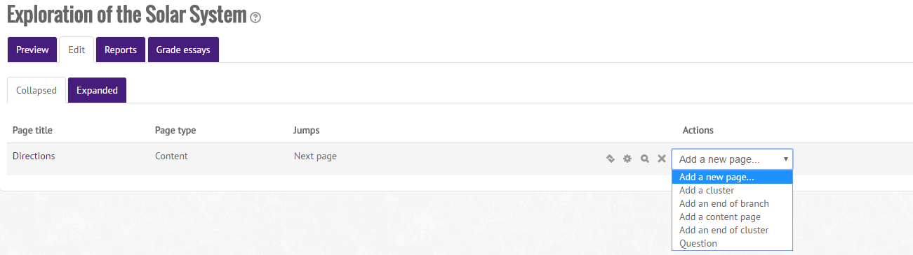
Adding More Pages
You can add as many pages as you want under the Edit tab.
A cluster is a group of question pages which will be offered randomly to a student as they work through the lesson.
We’ll add a question page next.

Slide 37
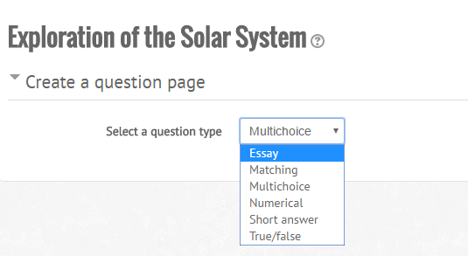
The Question Page
The Lesson activity supports many types of question pages.
Let’s create a multiple-choice question page next.

Slide 38
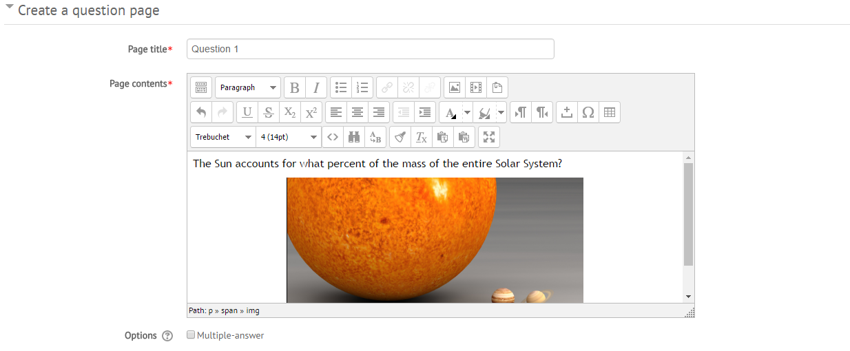
Creating a Multiple-Choice Question
Creating content for the question follows the same procedures as creating a label or editing a topic summary.
Note that myCourses does support multiple correct answers.

Slide 39
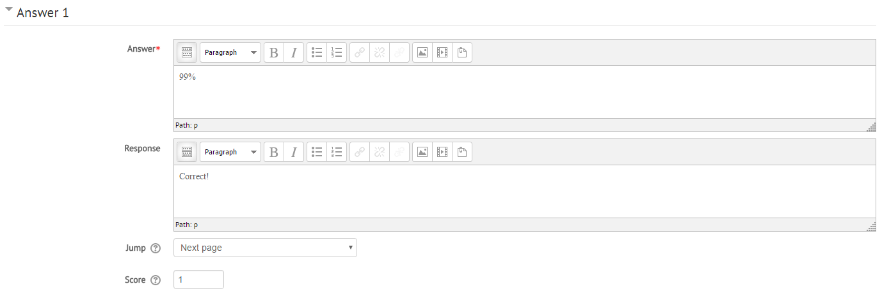
Creating the Choices
Each answer choice is edited in the same way as the question.
Here, you can create your own response to student answers.
The “Jump” menu dictates what happens when a student submits an answer.

Slide 40
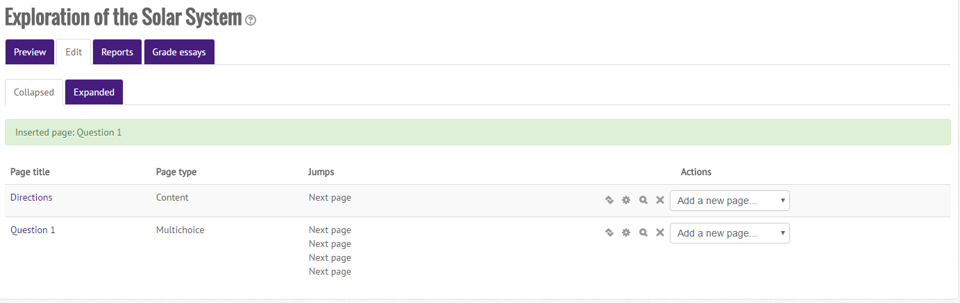
The Lesson So Far
We have a page for directions and a question page.
The question page contains a multiple-choice question.
Note the 4 “Jumps” on the question page.
I set each answer to progress to the next page after the student answers the question.
The myCourses default is for correct answers to advance to the Next page and incorrect answers to stay on the same page.

Slide 41
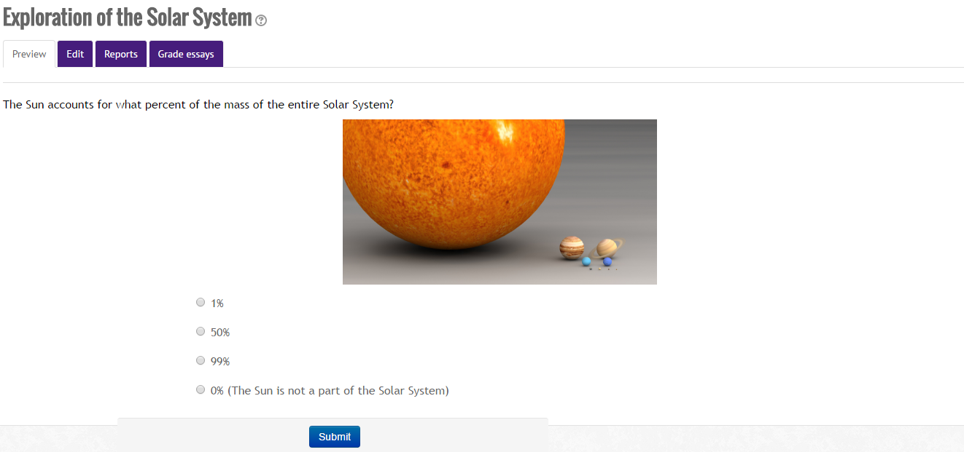
Question Page Preview

Slide 42
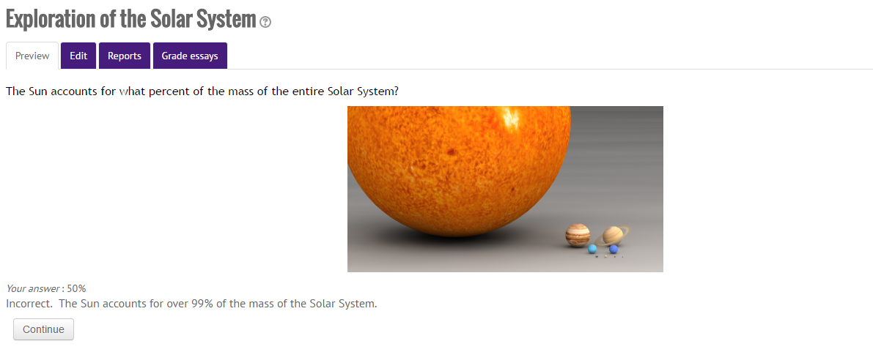
Response Preview
You may go through the lesson just as a student would.
This allows you to preview the responses and lesson behavior as well as the content.

Slide 43
Review of Topics Covered
Gradebook Aggregation
Weighted Mean, Simple Weighted Mean, and Natural allow for flexibility in grading student performance.
Course Beautification
Adding multimedia to topic summaries or labels improves the look of the course.
If a student is more interested in what’s happening, they will learn more.
Lessons
A lesson is a unique way of guiding students toward a concept or simply teaching a special topic.

